Slide 1

Deployment Models in Cloud Computing

Slide 2
Deployment Models
Private cloud
Public cloud
Hybrid cloud
Community Cloud

Slide 3
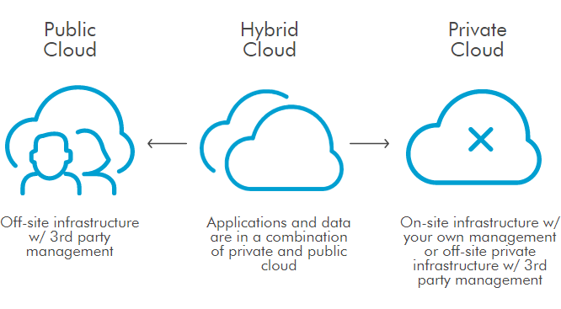
Deployment Models

Slide 4
Cloud Deployment Model
IT organizations can choose to deploy applications on public, private, or hybrid clouds, each of which has its trade-offs.
•The terms public, private, and hybrid do not dictate location.
•While public clouds are typically “out there” on the Internet and private clouds are typically located on premises, a private cloud might be hosted at a co- location facility as well.

Slide 5
Cloud Deployment Model
Public clouds. The cloud is open to the wider public.
Private clouds. The cloud is implemented with in the private premises of an institution and generally made accessible to the members of the institution or a sub- set of them.
Hybrid or heterogeneous clouds. This cloud is a combination of the two previous solutions and most likely identifies a private cloud that has been augmented with resources or services hosted in a public cloud.

Slide 6
Cloud Deployment Model
Community clouds. The cloud is characterized by a multi-administrative domain involving different deployment models(public, private and hybrid), and it is specifically designed to address the needs of a specific industry

Slide 7
Public Cloud
A public cloud provides services to multiple customers, and is typically deployed at a co-location facility.
Public clouds are run by third parties, applications from different customers are likely to be mixed together on the cloud’s servers, storage systems, and networks.
Public clouds are most often hosted away from customer premises, and they provide a way to reduce customer risk and cost by providing flexible, even temporary extension to enterprise infrastructure.

Slide 8
Public Cloud
Such clouds are appealing to users because they allow users to quickly leverage compute, storage, and application services.
In this environment, users’ data and applications are deployed on cloud datacenters on the vendor’s premises
If a public cloud is implemented with performance, security, and data locality in mind, the existence of other applications running in the cloud should be transparent to both cloud architects and end users

Slide 9
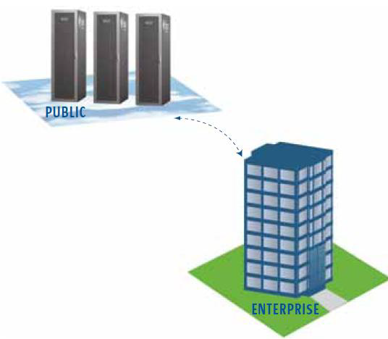
Public Cloud
One of the benefits of public clouds is that they can be much larger than a company’s private cloud might be, offering the ability to scale up and down on demand, and shifting infrastructure risks from the enterprise to the cloud provider, if even just temporarily.

Slide 10
Private Cloud
Private clouds are built for the exclusive use of one client, providing the utmost control over data, security, and quality of service.
The company owns the infrastructure and has control over how applications are deployed on it.
Private clouds may be deployed in an enterprise data-center, and they also may be deployed at a co-location facility.
Private clouds can be built and managed by a company’s own IT organization or by a cloud provider.

Slide 11
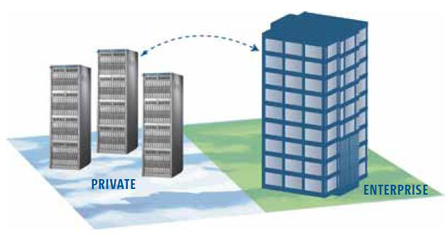
Private Cloud
This model gives companies a high level of control over the use of cloud resources while bringing in the expertise needed to establish and operate the environment .

Slide 12
Hybrid Cloud
Hybrid clouds combine both public and private cloud models.
They can help to provide on-demand, externally provisioned scale.
The ability to augment a private cloud with the resources of a public cloud can be used to maintain service levels in the face of rapid workload fluctuation.
This is most often seen with the use of storage cloud to support Web 2.0 applications.
A hybrid cloud also can be used to handle planned workload spikes

Slide 13
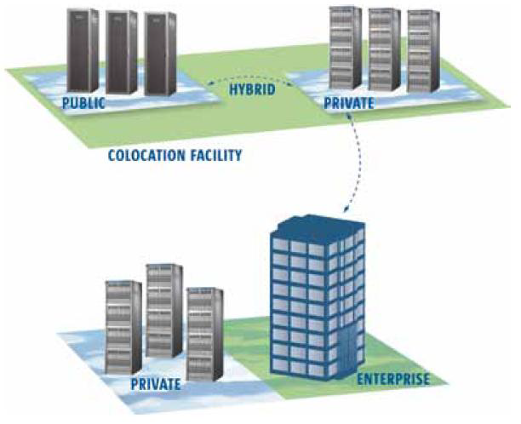
Hybrid Cloud
Hybrid clouds introduce the complexity of determining how to distribute applications across both a public and private cloud.
Among the issues that need to be considered is the relationship between data and processing resources
Issues is what has to be kept where?

Slide 14
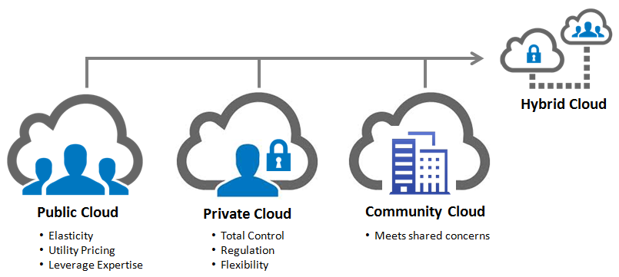
Comparison

Slide 15
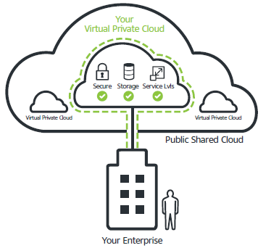
Virtual Private Cloud (VPC)

Slide 16
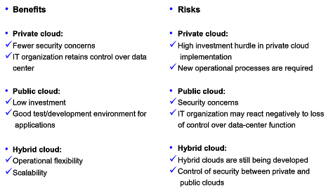
Pros and Cons of Each Model

Slide 17
Cloud Bursting
Cloud bursting is an application deployment model in which an application runs in a private cloud or data center and bursts into a public cloud when the demand for computing capacity spikes.
The advantage of such a hybrid cloud deployment is that an organization only pays for extra compute resources when they are needed.

Slide 18
QUIZ
A private cloud helps businesses reduce their cost in what two ways? (Choose two.)
It reduces infrastructure cost by adopting virtualization techniques.
It reduces infrastructure cost by owning all of the computing resources.
It reduces operating costs by having maximum control over the data and infrastructure.
It reduces infrastructure cost by consolidating computing resources and distributed computing.

Slide 19
How to choose Cloud
Finance
Does your business prefer spending CAPEX or OPEX on your IT Infrastructure?
Infrastructure
Do you have existing infrastructure that is less than two years old?
Facilities
Are your DC facilities in need of a refurbish/upgrade?
Network
Do you have an MPLS network?
Compliance
Are there any compliance or industry restrictions hosting applications that you are aware of?

Slide 20
How to choose Cloud
Headcount
Do you run a lean IT Division in terms of headcount?
Growth rate
Do you have trouble controlling server sprawl in your environment
Do you have a dynamic ever-changing environment?
Applications
Are your applications predominantly web based?

Slide 21
Money Calculation
Medium-sized organization: wishes to run a service for M months
Service requires 128 servers (1024 cores) and 524 TB
OUTSOURCE (lets say AWS)
S3 costs: $0.12 per GB month. EC2 costs: $0.10 per CPU hour Storage = $ 0.12 X 524 X 1000 ~ $62 K
–Total = Storage + CPUs = $62 K + $0.10 X 1024 X 24 X 30 ~ $136 K
Own: monthly cost
Storage ~ $349 K / M Total ~ $ 1555 K / M + 7.5 K (includes 1 sysadmin / 100 nodes)
•using 0.45:0.4:0.15 split for hardware: power: network and 3 year lifetime of hardware
Which is Better???

Slide 22
QUIZ
What is an advantage of building a private cloud infrastructure?
Private cloud enables business to reduce operating costs by having maximum control over the data and infrastructure.
Private cloud enables business to reduce operating costs by using their own IT department to manage computing resources.
An enterprise can reduce the cost from capital expenditures and IT infrastructure investment to an utility operating expense model.
An enterprise can consolidate hardware, storage, network by virtualizing resources to be more flexible, dynamic, & meet on demand requirements.

Slide 23
QUIZ
Which scenario best illustrates the benefits of using a hybrid cloud?
A. An enterprise whose IT infrastructure is underutilized on average, and the system load is fairly consistent.
B. Small start up business that is focused primarily on short term projects, and the system load is highly unpredictable.
An enterprise that is not too concerned about control over their data and has large existing infrastructure that is capable of handling future needs.
An enterprise that needs highly controlled storage and access to their data and that has a large existing infrastructure but needs additional resources for test and development of new solutions.

Slide 24
Service models of Cloud
Cloud computing can describe services being provided at any of the traditional layers from hardware to applications
The service models are as follows:
Software as a Service (SaaS)
Platform as a Service (PaaS)
Infrastructure as a Service (IaaS)
XaaS (Anything as a Service) / Everything as a Service

Slide 25
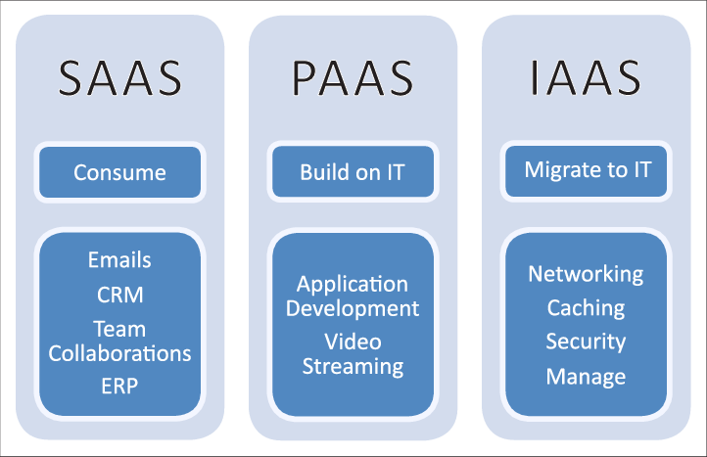

Slide 26
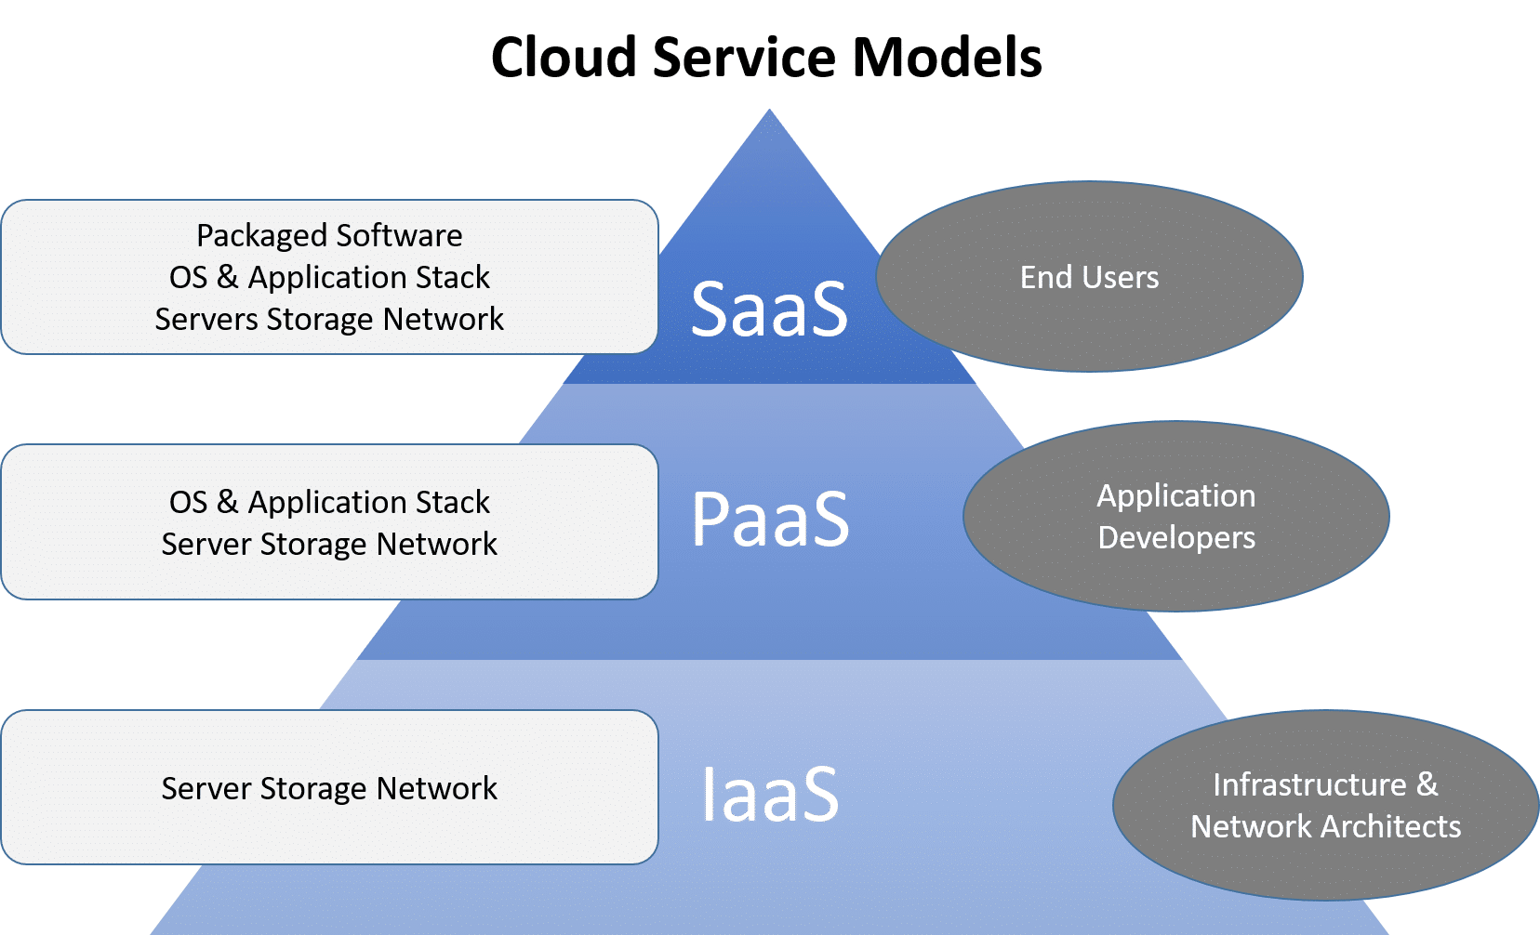

Slide 27
Software as a Service (SaaS)
At the top of the stack, SaaS solutions provide applications and services on demand.
•Most of the common functionalities of desktop applications are replicated on the provider’s infrastructure and made more scalable and accessible through a browser on demand.
•These applications are shared across multiple users whose interaction is isolated from the other users.
•The SaaS layer is also the area of social networking Websites, which leverage cloud-based infrastructures to sustain the load generated by their popularity

Slide 28
Software as a Service (SaaS)
A single instance of the software runs on the cloud and services multiple end users or client organizations
The most widely known example of SaaS is:
salesforce.com
Google Documents
Facebook
Flickr

Slide 29
Platform as a Service (PaaS)
PaaS solutions are the next step in the stack.
They deliver scalable and elastic runtime environments on demand and host the execution of applications.
These services are backed by a core middleware platform that is responsible for creating the abstract environment where applications are deployed and executed.
It is the responsibility of the service provider to provide scalability and to manage fault tolerance, while users are requested to focus on the logic of the application developed by leveraging the provider’s APIs and libraries.

Slide 30
Platform as a Service (PaaS)
This approach increases the level of abstraction at which cloud computing is leveraged but also constrains the user in a more controlled environment.
PaaS offerings can provide for every phase of software development and testing, or they can be specialized around a particular area such as content management

Slide 31
Platform as a Service (PaaS)
There are at least two perspectives on PaaS depending on the perspective of the producer or consumer of the services:
A. Someone producing PaaS might produce a platform by integrating an OS, middleware, application software, and even a development environment that is then provided to a customer as a service.
B. Someone using PaaS would see an encapsulated service that is presented to them through an API.

Slide 32
Platform as a Service (PaaS)
Commercial examples of PaaS include:
The Google Apps Engine, which serves applications on Google’s infrastructure.
Windows Azure
Hadoop
Aneka

Slide 33
Infrastructure as a Service (IaaS)
At the base of the stack, IaaS solutions deliver infrastructure on demand in the form of virtual hardware, storage, and networking.
These are created at users’ request on the provider’s infrastructure, and users are given tools and interfaces to configure the software stack installed in the virtual machine.
•IaaS delivers basic storage and compute capabilities as standardized services over the network. Servers, storage systems, switches, routers, and other systems are pooled and made available to handle workloads that range from application components to high-performance computing applications

Slide 34
Infrastructure as a Service (IaaS)
Commercial examples of IaaS:
Joyent, whose main product is a line of virtualized servers that provide a highly available on-demand infrastructure.
Amazon EC2
S3
Rightscale
vCloud

Slide 35
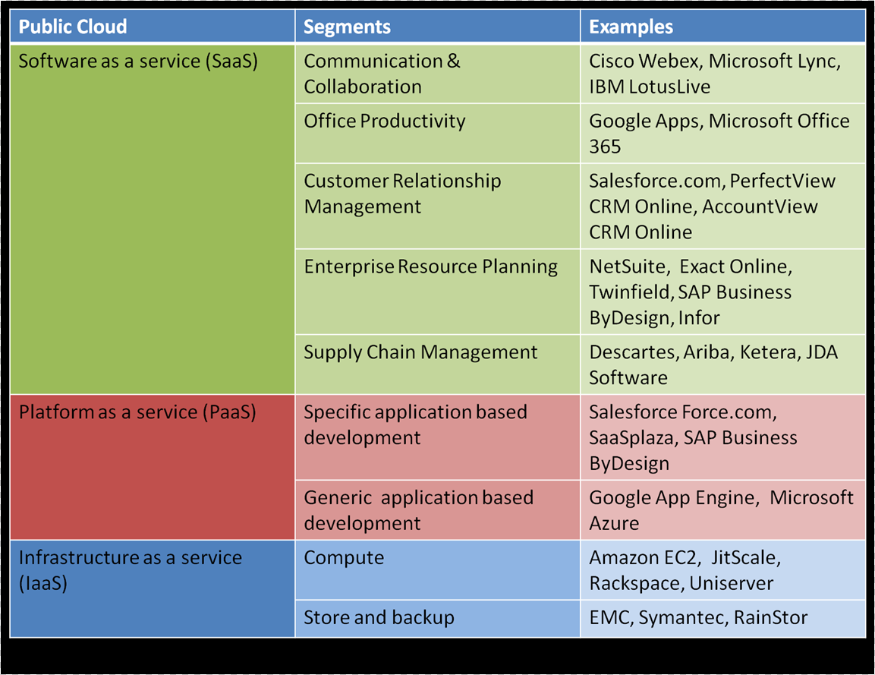

Slide 36

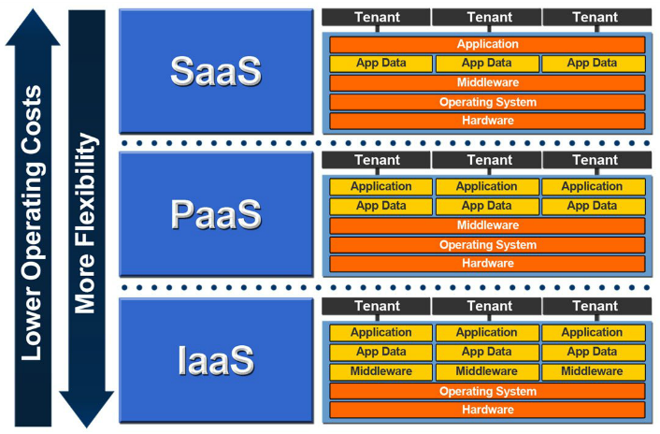

Slide 37
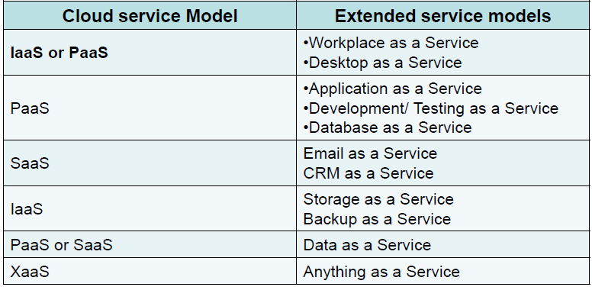

Slide 38
Other kinds of XaaS
Database as a Service (DBaaS),
Storage-as-a-Service,
Desktop as a Service (DaaS),
Communications as a Service (CaaS),
Iot as a Service (Iotaas)
Monitoring as a service (MaaS)

Slide 39
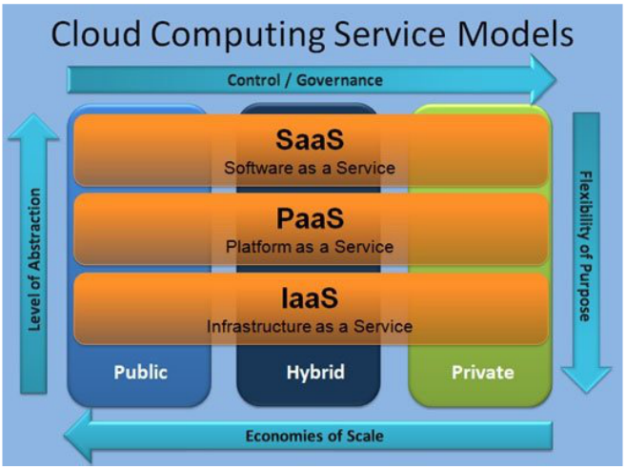

Slide 40


